Slide 1
The Best Programming Language
APRIL 2026

Slide 2
Contents
01
The Assembly Programmer Parallel
02
The Paradigm Inversion
03
Spec-Driven Development
04
Four Engineer Shapes
05
The Certification Question

Slide 3
The Assembly Programmer Parallel
01
History is repeating itself

Slide 4
When COBOL Arrived
The appearance of COBOL wiped out some jobs, but it also created new ones.
- Assembly programmers managed every register, every memory address by hand
They spoke machine language
- COBOL abstracted that mastery away
- Assembly programmers didn't vanish overnight
- 70% of financial transactions still run in COBOL (200 – 300 billions lines of code)
Notes:
the COBOL transition it took decades, but there was no turning back

Slide 5
Change is like radiation. You don't feel it but it's all around you. ”
And if you don't move quickly, it will kill you

Slide 6
A New Abstraction Layer
The hard lessons made us stronger
- Real systems built. Real failures learned.
- That hard-won judgment does not go away — that is not being replaced
- But a new abstraction layer has appeared above everything you mastered
- Not gradually. Overnight.
Pretty similar as back in the 60s…

Slide 7
You are the Assembly programmer of today. ”
Figuratively
Notes:
Y no es un comparativo de obsolescencia sino de actualidad… hoy somos buenos en lo que hacemos pero llegó algo grande

Slide 8
The Paradigm Inversion
02
The machine learned our language

Slide 9
The machine understands human language now.”
No syntax. No brackets. Just clear thinking in plain sentences

Slide 10
What This Means in Practice
Just as COBOL abstracted away the Assembly programmer's register-level mastery, Gen AI is abstracting away the modern developer's syntax-level mastery
- AI makes coding faster → smaller teams → fewer seats
- The developer who would have been the 6th hire is now never needed
- Junior entry-level work — their training ground — has been devoured
- Syntax-level mastery is being absorbed into a higher layer

Slide 11
Spec-Driven Development
03
Human language as the instruction set

Slide 12
Every Generation Freed Us to Think Higher
Take the Java language as an example
- Java → compiler → .class → JVM (written in C++, C and assembly) → Assembly: we stopped managing each layer
- New Java versions only require new C++ modules
- Human language specs are the new level of abstraction
Human Language
Java
C – C++
as
Notes:
OJO: el compilador está hecho en Java

Slide 13
What SDD Changes
- No semicolons, no brackets — just clear thinking in plain language
- You focus on the what. The AI handles the how.
- Good grammar carries the same weight as good syntax
- Design patterns matter more than naming conventions
- Every hour clarifying specs and standards is worthwhile

Slide 14
Good grammar will matter as much as good syntax.”
The new craft

Slide 15
The lack of specs will become the technical debt of the future.”
The same way that the lack of unit tests haunts legacy applications today
Notes:
No surprise if SonarQube starts adding “Specs check” as a gate check

Slide 16
Four Engineer Shapes
04
Which profile survives the AI era?

Slide 17
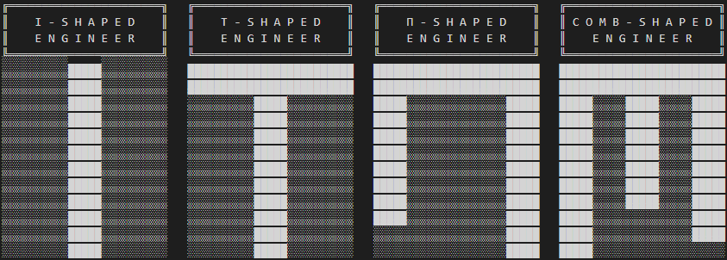
I, T, Pi, and M-Shaped Engineers
- I-shaped: deep specialist, one domain
- T-shaped: genuine depth + breadth to bridge, translate, and wear multiple hats
- Pi-shaped: two areas of expertise
- M-shaped: multiple peaks of expertise

Slide 18
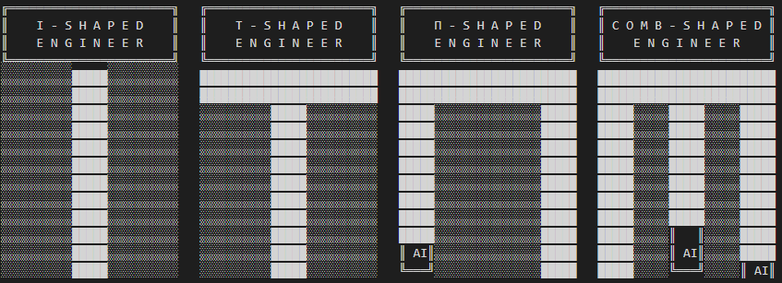
I, T, Pi, and M-Shaped Engineers
- I-shaped: deep specialist, one domain
- T-shaped: genuine depth + breadth to bridge, translate, and wear multiple hats
- Pi-shaped: two areas of expertise
- M-shaped: multiple peaks of expertise — AI amplifies each peak, but zero multiplied by AI still zero
Notes:
AI does not create what it does not exist. Anything multiplied by zero still zero

Slide 19
An AI augmented average engineer could match the experienced in coding.”
Not in judgement or broad experience

Slide 20

A REAL-WORLD EXAMPLE
The Data Migration Project
One architect – all roles. Python project. No Python developer needed.
A customer needed Python for a multi-terabyte file migration using 3rd party APIs. I am not a Python developer. But I volunteered — and ran the entire project end-to-end alone: architect, PM, developer, reviewer. The M-shaped profile was not the outcome. It was the prerequisite.
BMAD-Method team of agents made all the leg work, I just orchestrated
Two weeks of project saved

Slide 21
The Program Language Certification Question
05
What is still worth your time?

Slide 22
The developer who spends the next five years perfecting their syntax mastery is making the same bet the Assembly programmer made in 1975 ”
and we know how that story ended

Slide 23
Why hyper-specialize in one language when you can speak them all?”
The new question

Slide 24
Getting a language program certification is not worth it.”
Is not easy to say it, but expanding knowledge is more valuable than delving deeper into it

Slide 25
Today's languages will become the COBOL of the future.
The real revolution
Notes:
Conseguir un dev COBOL es muy difícil Las Univer enseñarán cada vez menos lenguajes y más AI COBOL displaced Assembly, AI is displacing the code.

Slide 26
The best programming language for AI is English!
Or your native human language

Slide 27

Thank you!
Edgar Alvarez
Head of Core Engineering
edgar_alvarez1@epam.com
Please rate this talk

